Slide 1
Nursing Home Incident Command System (NHICS)
2017 Revision
Notes:
Welcome to the 2017 NHICS training! These training modules reflect the updated and streamlined 2017 NHICS and replace the previous 2011 training material.

Slide 2
Course Introduction
This course is divided into 4 Modules:
1: Personal Emergency Preparedness
2: NHICS Guidebook
3: Response Toolkit
4: Planning Toolkit and Implementing NHICS
Notes:
Course Introduction
This course is divided into 4 Modules:
Module 1 covers Personal Emergency Preparedness because preparedness begins at home with yourself and household members
Module 2 covers the essential information contained in the NHICS Guidebook
Module 3 covers the Response Toolkit which includes all of the tools used for immediate response through recovery and demobilization
Module 4 covers the Planning Toolkit in addition to implementing NHICS at your facility

Slide 3
Module Structure
Each Module includes:
Objectives
Knowledge Checks for self evaluation
Summary with links to additional information
Notes:
Module Structure
Each Module includes:
Objectives
Knowledge Checks for self evaluation (short quizzes to test what you’ve learned)
Summary with links to additional information

Slide 4
Course Overview
This training course will cover the tools to:
Prepare you and your family
Apply the principles of NHICS to quickly respond to emergencies in your work environment
Assist your healthcare facility in meeting its disaster responsibilities
Notes:
Course Overview
This training course will cover the tools to:
Prepare you and your family
Apply the principles of NHICS to quickly respond to emergencies in your work environment
Assist your healthcare facility in meeting its disaster responsibilities

Slide 5
Why Use NHICS?
The Nursing Home Incident Command System:
Is a practical, standardized approach for dealing with emergencies (not the same “business as usual”)
Uses a common language that all affected facilities and response agencies can recognize
Is flexible and scalable to accommodate the demands of the incident and optimize your facility’s response
Notes:
Let’s consider why it may be so helpful for a nursing home to become familiar with NHICS. Let’s say a “disaster” is a really big problem that you didn’t expect. Examples include: your facility lost power and the backup generators failed; a tornado ripped away part of your building; or there is an active shooter in your facility. In all of these situations, a number of problems are created and response priorities must be quickly identified (e.g., it would be a priority to safely evacuate residents from a structurally damaged building). NHICS enables you to create an organizational structure and develop a road map to optimally manage the incident relative to the situational circumstances.
Why isn’t the normal, day-to-day organizational system used by each nursing home sufficient to manage a disaster? The answer is that disasters are not “business as usual”; they are, by definition, extraordinary events that place highly unusual stresses on the facility, including the management team and staff that work at the facility. Effectively responding to a disaster requires additional skills that must be acquired before the disaster occurs. If this document conveys only one important point, it is that each facility should commit to preparing in advance for such an event. Preparing in advance is a responsibility each facility has to their residents, staff and visitors; and it also assists the facility with maintaining business operations with a minimum of disruption. NHICS acknowledges that personal and family preparedness is essential so that staff can be available to meet their work responsibilities.
NHICS can be used by anyone who understands the basic functional requirements necessary for establishing goals and objectives to meet the operational needs of an incident.
Using NHICS provides the added benefit of applying a universal “ICS” system. Impacted healthcare facilities such as hospitals and nursing homes and response agencies such as fire, law, emergency management and public health use ICS. So by learning and practicing NHICS, nursing homes can communicate more effectively with response partners, and thereby eliminate much of the confusion that sometimes arises when differently trained entities need to communicate.
NHICS is always scalable – many simple incidents may require only the activation of a single person, the Incident Commander, who can handle all of the necessary tasks. But in a larger, more impactful incident, more Incident Management Team (IMT) positions may be needed. The Incident Commander makes the decision to “size up” the IMT as necessary. The scalability of NHICS, along with other features, makes the system flexible and therefore adaptable to the nursing home’s needs.

Slide 6
Why plan ahead?
As a healthcare worker, you are at the front lines of disaster response at your facility
Most emergencies occur with no “advance warning”
Being prepared will help ensure you can meet your responsibilities to work and family
Notes:
Why plan ahead?
There are many reasons why we plan ahead.
As a healthcare worker, you are at the front lines of disaster response at your facility
Most emergencies occur with no “advance warning”
Being prepared will help ensure you can meet your responsibilities to work and family

Slide 7
Hurricane Katrina Lesson Learned
“Life and death in the critical first hours of a calamity typically hinged on the preparedness, resources, and abilities of those in the affected community with the power to help themselves and others in their vicinity. Those who did better were those who didn’t wait idly for help to arrive.”
From “Five Days at Memorial Medical Center” by Sheri Fink
Notes:
Hurricane Katrina Lessons Learned
This quote is from “Life and Death in a Storm-ravaged Hospital: Five Days at Memorial Medical Center” by Sheri Fink. The book details the aftermath of Hurricane Katrina at Memorial Medical Center in New Orleans in August of 2005 and is an expansion of her Pulitzer winning article authored by Fink. The book details the harsh reality of conditions at Memorial Medical Center detailing the suffering of patients, families and staff, and the importance of being prepared to respond.
The action of preparing ourselves and our family gets us physically and mentally ready to optimally deal with an emergency. The same can be said for being prepared in the workplace. Disaster planning at your facility is the key to effective, efficient response. Regardless of whether you are an administrator, supervisor or healthcare worker, this training will better prepare you to deal with an emergency.
Photo credit: CDC

Slide 8
MODULE 1: Personal Emergency Preparedness
Notes:
MODULE 1
Module 1 covers Personal Emergency Preparedness.

Slide 9
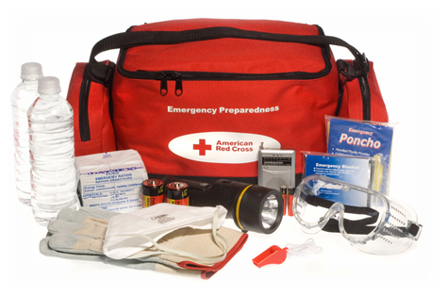
Objectives - Module 1
Understand personal emergency preparedness
Become familiar with the tools available for personal and professional readiness
Emergency Kit
Family Emergency Communication Plan
Family Preparedness Skills
Notes:
Objectives -- Module 1
Understand personal preparedness and become familiar with the tools available for personal and professional readiness.
Tools include having a Emergency Kit, Family Emergency Communication Plan and Family Preparedness Skills.

Slide 10
Reality of your role in disaster
You are the first responder for your residents!
It’s difficult to be there for them if you and your loved ones aren’t prepared.
The planning and thought you invest in preparedness now will ensure your readiness to respond to when disaster strikes.
Notes:
You are the first responder for your residents, but it’s more difficult to be there for them if you and your loved ones (family, pets, etc.) are not prepared. The planning and thought you invest in personal and family preparedness now will ensure your readiness to respond when disaster strikes.
We’ve all seen how emergencies can bring out the “best” in people who are prepared and committed. Preparing in advance is essential to successful response.

Slide 11
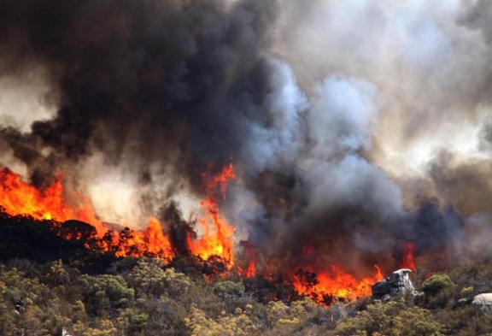
Start preparing now!
Meet with household members to create an emergency plan
Engage all household members in developing a practical and acceptable plan
Write down the key plan elements
Ensure everyone knows the plan
Notes:
Start now preparing now!
Meet with household members to create an emergency plan
Engage all household members in developing a practical and acceptable plan
Write down the key plan elements
Ensure everyone knows the plan
Photo: Courtesy of CAL FIRE

Slide 12
Preparedness Skills
Familiarize your household with these skills:
How and when to dial 911
Floor plan of your home with escape routes
How and when to shut off utilities including gas, electricity and water
How to use a fire extinguisher
Practice regularly!
Notes:
Preparedness Skills
Familiarize your household with these skills:
How and when to dial 9-1-1
Floor plan of your home with escape routes
How and when to shut off utilities like gas, electricity and water
How to use a fire extinguisher
Practice with all members of your family regularly. These are things that we don’t often think about until the emergency happens.
Photo Credit: FEMA/Christopher Mardorf – Oct 22, 2014

Slide 13
Family Emergency Communication Plan
Collect and store contact information for every household member
Contact information should be easily accessible
Best to collect multiple contact numbers if possible
Share information with all household members
Written and electronic is best
Update as needed
Notes:
Family Emergency Communication Plan
Collect and store contact information for every house hold member.
Contact information should be easily accessible
Best to collect multiple contact numbers if possible
Share information with all household members
Written and electronic is best
Update as needed
It is also useful to teach younger children how to make emergency calls and out-of-area phone calls. FEMA offers family preparedness materials and other resources that reach young children. https://www.fema.gov/children-and-disasters

Slide 14
Family Emergency Communication Plan…
Include the following in your Plan:
Household Information
“In Case of Emergency” (ICE) Contacts
Pre-Established Emergency Meeting Places
Medical Information
School, Childcare, Caregiver and Workplace Emergency Information
Notes:
Family Emergency Communication Plan…
FEMA’s template for a Family Emergency Communication Plan includes many elements, including:
Household Information
“In Case of Emergency” (ICE) Contacts
Pre-Established Emergency Meeting Places
Medical Information
School, Childcare, Caregiver and Workplace Emergency Information
In an emergency, who will pick up your child if you are not available? Who is your back-up designee if that person is unavailable? Have these “back up” individuals been identified as such to the school, childcare provider, caregiver, or workplace?
Additional contact information may include:
Police
Fire
Poison Control 1-800-222-1222
Hospital, Doctors, Pediatricians, Dentist, etc.
Insurance (Medical, Flood, Homeowners)
Gas, Water, Electric Company
Out-of-Area contacts

Slide 15
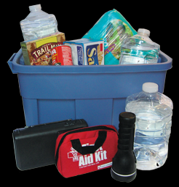
Emergency Kit
Your emergency kit should include the following:
Food and Water
First Aid Kit
Emergency Radio (hand crank or battery operated)
Tools/Supplies, including extra batteries
Medical Necessities
Notes:
Emergency Kit
Your emergency kit should include the following:
Food and Water
First Aid Kit
Emergency Radio (hand crank or battery operated)
Tools/Supplies, including extra batteries
Medical Necessities
All kit items may be stored in a waterproof bin or bag to keep the contents dry during rain or flooding. Your emergency kit may customized to fit in your vehicle or at work, in addition to having supplies at home. Make sure everyone knows wee the Emergency Kit is located.
In addition, you may want to consider preparing a ready “Go Kit” at home that includes items you may need if you are unexpectedly called back to work due to the emergency, e.g., personal hygiene items, change of clothes, medications, etc.) By gathering these items in advance, you will be able to respond to work faster.
Photo credit: CDC

Slide 16
Emergency Food
3-5 days of non-perishable food per person (and per pet!)
Ready-to-eat meals may include:
Canned soups and vegetables
Nuts and dried fruit
Meals Ready to Eat (MREs)
Manual can opener
Disposable utensils and plates/bowls
Check every six months for shelf life expiration; rotate
Notes:
Emergency Food
You will need at least a 3-5 day supply of non-perishable food per family member, including pets. You may want to store more than this amount. Remember, it is better to have extra food that you can share rather then run out of food during an emergency.
Choose foods that last a long time (i.e., have a long shelf life), do not need to be refrigerated, and are easy to prepare. Also, try to choose items that are high in calories and nutrition. Ready-to-eat meals may include:
Canned soups and vegetables
Nuts and dried fruit
Meals Ready to Eat (MREs)
Plan ahead for family members with special diets and allergies, including babies and elderly people. Consider special canned foods, juices, and soups appropriate to their needs. Nursing mothers should include formula in case they are unable to breastfeed during the emergency.
Make sure you have:
Manual can opener
Disposable utensils and plates/bowls
Check every six months for shelf life expiration; rotate stock with everyday supplies

Slide 17
Emergency Water
At least 1 gallon per person per day for 3 days (Half may be used for drinking and half for washing and cooking)
At least 1/2 gallon per pet per day for 3 days
Drink only clean water and stay hydrated!
Example: A family of 4 people and 2 pets would need
(4 people x 1 gal x 3 days) + (2 pets x ½ gal x 3 days)
= 12 + 3 gal = 15 gallons (and more is better)
Notes:
Emergency Water
At a minimum, each person in the household should have at least 1 gallon of water per day for 3 days. A normally active person needs to drink at least one-half gallon of water each day. If a person is active, he/she will require more water. You will also need water for cleaning and cooking. Remember that family pets need water too. (This means a family of 4 with 2 pets needs 15 gallons of water in their minimum 3-day emergency supply.)
Stay Hydrated
In an emergency, drink at least 2 quarts (one-half of a gallon) of water each day. Children, pregnant women, people who are sick, and people living in hot climates should drink more depending on circumstances. Do not risk dehydration by rationing water as dehydration can cause serious health problems. If water supplies are low, prioritize the water for drinking rather than cleaning or cooking.
Drink Only Clean Water
If you run out of safe drinking water in an emergency, there are steps you can take to make contaminated water safe to use. Visit CDC's Healthy Water website for instructions on how to make water safe for drinking or cooking. Untreated water can make you very sick because it often contains toxic chemicals, heavy metals, and germs. Never drink flood water.
https://www.cdc.gov/healthywater/emergency/drinking/emergency-water-supply-preparation.html
Photo Courtesy of CDC.

Slide 18
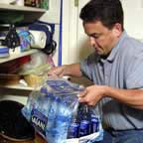
Emergency Water – Option 1
Pre-packaged bottled water is the safest, most reliable approach.
Do not open until you need to use it
Keep in original container
Rotate and replace before expiration/“use by” date
Notes:
Emergency Water – Option 1
Buy and store pre-packaged bottled water. This is the safest, most reliable option:
Do not open the containers until you're ready to use
Keep water in original container
Rotate and replace before expiration or “use by” date
Emergency Water - Option 2 is to fill your own bottles and treat the water appropriately (see next slide)
Photo Courtesy of CDC.

Slide 19
Emergency Water – Option 2
Use food-grade water storage containers
Clean containers before using to store water
Wash and rinse container using dish soap
Mix 1 tsp. of household bleach with 1 qt. (1/4 gallon) of water
Swish the solution around
Rinse well with clean water
Store in a cool, dark place
Re-clean and replace water every 6 months
Notes:
Emergency Water – Option 2
Use food-grade water storage containers, like those found at surplus or camping supply stores.
Clean containers before using to store water
How to clean containers for water storage:
Wash containers with dishwashing soap
Rinse with water
Mix 1 teaspoon of household bleach with 1 quart (1/4 gallon) of water
Swish the solution around in the container. Make sure it touches all inside surfaces
Rinse well with clean water
Store in a cool, dark place
Re-clean and replace water every 6 months
Photo Courtesy of CDC.

Slide 20
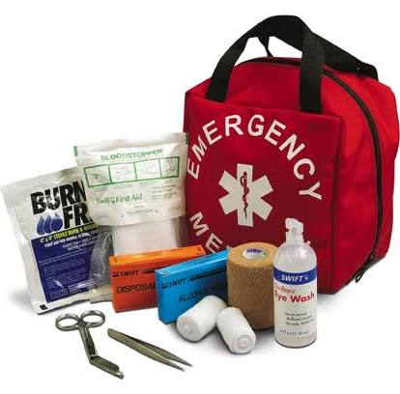
First Aid Kit
Adhesive bandages
Safety pins
Latex gloves
Medications
Scissors
Thermometer
Tape and gauze
Antiseptic and ointments
Notes:
First Aid Kit
Medical items to have include:
Adhesive bandages
Safety pins
Latex Gloves
Medications
Scissors
Thermometer
Tape and gauze
Antiseptic and ointments
Most of these medical supplies can be found in a standard first aid kit available at most stores for minimal cost. Add any special items your family members require.

Slide 21
Tools and Supplies
Battery-powered or hand crank radio
NOAA Weather Radio
Whistle to signal for help
Dust mask
Duct tape
Wrench or pliers to turn of utilities
Utility knife
Extra batteries
Notes:
Tools and Supplies
Tools and other supplies for your kit may include:
Battery-powered or hand crank radio – can be used when the electricity goes out
NOAA Weather Radio – to hear critical messages on current and upcoming weather systems, watches and warnings issued, and EAS messages
Whistle to signal for help – if trapped in an enclosed space where no one can see you, you can whistle to alert responders or passers by that you are trapped and need help
Dust mask – protection from small particulate in the air like smoke or dust
Duct tape – can be used for many purposes.
Wrench or pliers to get leverage and turn of utilities
Utility Knife - to cut food, packaging, rope, and boxes
Extra batteries for kit items like your NOAA Weather Radio

Slide 22
Tools and Supplies…
Cash
Personal hygiene items
Paper products (cups or bowls)
Rain gear
Extra blankets
Flash light, headlamp and light sticks
Shoes
Hats/head protection
Notes:
Tools and Supplies…
Other useful tools and supplies include:
Cash – it is possible that ATM machines might not be working in an emergency so it is good to have cash on hand to make emergency purchases
Personal hygiene items – hand sanitizer, women’s hygiene products, soap, toothpaste/brush, dry shampoo, etc.
Paper products (cups or bowls) – for food prep and eating/drinking
Rain gear – waterproof hat, poncho and/or pants
Extra blankets – for cold weather conditions and sleeping
Flash light, headlamp and light sticks – power outages are common in disasters
Shoes – Sturdy, waterproof boots are good to have for working in disaster impacted areas
Hats/head protection – hard hats for disaster zones, sun protection for outdoor work and a beanie or insulated cap for cold weather conditions

Slide 23
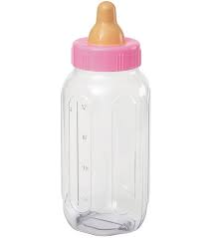
Emergency Supplies for Infants
Formula, diapers, and wipes
Child carrier
Change of clothes
Blankets and/or portable sleeper
Comfort item/toy (pacifier, etc.)
Medications
Nonperishable foods
Notes:
Emergency Supplies for Infants
Emergency supplies for Infants may include:
Formula, diapers and wipes
Child carrier
Change of clothes, blankets and/or portable sleeper
Comfort item/toy (pacifier, teddy bear, etc.)
Medications
Nonperishable foods
Additional directions for breast feeding moms:
Keep baby skin to skin
Feed on demand (or at least every 2-3 hours)
Baby may get fussy due to delayed let-down, use breast massage and deep breathing and milk will flow
Help baby to latch on by reclining mom and triggering baby’s feeding reflexes
If needed, hand express and spoon or cup feed
Other directions for formula fed babies:
3 days worth of pre-washed bottles (to be used only once if unable to wash) and formula or disposable cups
Ready-made formula or sterile water to mix formula
Substitute for infant formula – may used for a few days until manufactured formula or mothers milk is available
Boil 1/3 cup of water
2/3 cup of boiled cow’s milk
1 level teaspoon of sugar
Source information: California Department of Public Health (December 2012). Verify this information with your healthcare provider.

Slide 24
Emergency Supplies for Children
Extra change of clothes and hygiene items
Familiar non-perishable foods
Games, books or puzzles
Comfort items from home
Batteries and chargers for electronics – music players and games
Medications
Notes:
Emergency Supplies for Children
Emergency Supplies for Children may include:
Extra change of clothes and hygiene items
Familiar non-perishable foods
Games, books or puzzles
Comfort items from home
Batteries and chargers for electronics – music players and games
Medications
Aside from basic items like food, water and personal hygiene products, other emergency supplies for children can be customized based on what they enjoy. They will need things to do keep them occupied when waiting out a disaster. Games, books and puzzles are useful, as are electronic tablets, gaming devices, music players and other electronics. Comfort items from home can help younger children feel less frightened.

Slide 25
Emergency Supplies for Pets
Crate or carrier for each pet with:
ID, photo and vaccination records
Dry pet food and extra water
Medications and special needs
Leash and/or muzzle
Consider micro-chipping for identification
Bowls
Blankets
Notes:
Emergency Supplies for Pets
Emergency supplies for pets may include:
Crate or carrier for each pet with:
ID, photo and vaccination records
Dry pet food and extra water
Medications and special needs
Leash and/or muzzle
Consider micro-chipping the pet for identification
Bowls
Blankets
If you must evacuate your home in a crisis, plan for the worst-case scenario. Even if you think you may be gone for only a day, assume that you may not be allowed to return for several weeks. When recommendations for evacuation have been announced, follow the instructions of local and state officials. To minimize evacuation time, take these simple steps: Make sure all pets wear collars and tags with up-to-date identification information. Your pet’s ID tag should contain the pet’s name, your telephone number and any urgent medical needs. Be sure to also write your pet’s name, your name and contact information on your pet’s carrier.
The ASPCA recommends microchipping your pet as a more permanent form of identification.
Photo credit: ASPCA.org

Slide 26
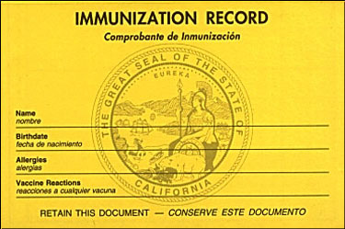
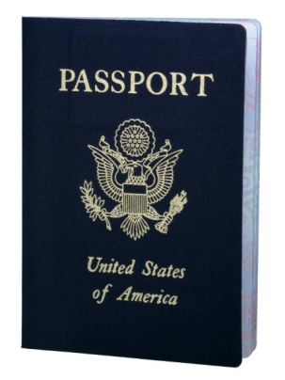
Important Documents
IDs, Passports, Birth Certificates
Immunization records
Banking and credit card accounts
Social Security cards
Insurance policies
Wills and trusts
Contracts and deeds
Notes:
Important Documents
Important documents may include:
IDs, Passports, Birth Certificates
Immunization records
Banking and credit card accounts
Social Security cards
Insurance policies
Wills and trusts
Contracts and deeds
Having important documents handy when recovering from an emergency is key. Having these documents destroyed in a house fire or other disaster is creates unnecessary problems and may slow the recovery process.
Other important documents may include:
Family photo albums
Electronics (portable hard drive, USB devices)
Marriage license
Checkbook(s)
Tax information

Slide 27
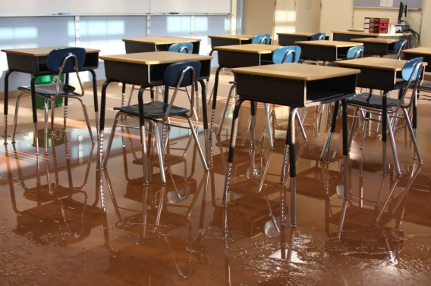
Child Care
Make arrangements to pick up and care for your child during an emergency by ensuring:
The day care provider or school has your emergency contact information and know it’s okay to release your child to your emergency/back-up designee(s)
The designee knows where and when to go
Notes:
Child Care
Making arrangements for emergency situations with your child care provider, school, family member or neighbor is very important. We typically do not receive advance warning when disaster strikes you have to be ready at all times.
It may be that you cannot fulfill your obligation to pick up and care for your child during a disaster. Make alternate arrangements in advance for a designated person to pick up and care for your child in an emergency by ensuring:
The day care provider or school has your emergency contact information and know it’s okay to release your child to your emergency/back up designee(s)
The designee knows where and when to go
Photo Credit - FEMA Photo/Judith Grafe - Location: Windham, N.Y., September 1, 2011 -- Classes in the WAJ Central School will be delayed their September opening until the water and mud can be cleaned up. The school was damaged from the flooding caused by Hurricane Irene.

Slide 28
Considerations for Self-Care
During an emergency:
Hydrate and eat regularly
Pace yourself; take breaks when necessary
Safeguard yourself by wearing Personal Protective Equipment (PPE) if necessary
Limit time spent working in high-intensity settings
Check in with your supervisor regularly
Notes:
Considerations for Self-Care
Considerations for Self-Care during an emergency:
Hydrate and eat regularly
Pace yourself; take breaks when necessary
Safeguard yourself by wearing PPE if necessary
Limit time spent working in high-intensity settings
Check in with your supervisor regularly
The Substance Abuse and Mental Health Services Administration (SAMHSA) offers tips for disaster responders to reduce stress.
Source: SAMHSA Tips for Disaster Responders: Preventing and Managing Stress: http://store.samhsa.gov/shin/content/SMA14-4873/SMA14-4873.pdf

Slide 29
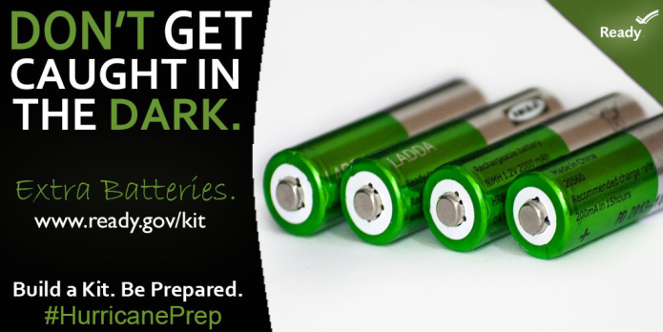
Knowledge Check - Question 1
Which of these items would be useful to have in your emergency kit?
First Aid Kit
Rain poncho
Hand-crank or battery-operated radio
Backup batteries
All of the above
Notes:
Knowledge Check – Question 1
The correct answer is E. All of the above. Any of these items could come in handy during an emergency and be useful in your emergency kit.
Photo Credit: FEMA, Jana Baldwin – May 8, 2015

Slide 30
Knowledge Check - Question 2
Which of the following should your family emergency communication plan include?
Emergency Meeting Places
In Case of Emergency (ICE) Contact
Important Medical Information
School, Child Care, Care Giver Contacts
All of the above
Notes:
Knowledge Check – Question 2
The correct answer in E. All of the above. The family emergency communications plan includes fields of entry for the information above and more. Collect what you need for your family.

Slide 31
Knowledge Check – Question 3
Microchipping is a recommended practice to ensure a more permanent form of identification for your pet?
True
False
Notes:
Knowledge Check – Question 3
True. ASPCA recommends microchipping for all pets as a more permanent form of identification. It also helps to ensure you get your pet back should you become separated during an emergency. It’s also helpful to have photos of your pet.
https://www.ready.gov/animals

Slide 32
Knowledge Check – Question 4
The easiest method for getting emergency water supplies for your household (people and pets) is:
Pre-packaged Bottled Water
Food-grade water storage containers
Dig a well…saw it on Bear Grylls show!
Boil questionable water
Notes:
Knowledge Check – Question 4
The correct answer is A. Pre-packaged Bottled Water. It can be purchased at any store, involves zero prep work, and stores well when left away from sunlight at room temperature or cooler.

Slide 33
Summary
In Module 1, you learned it is important to:
Maintain Emergency Kit(s) for all of your family members, including pets
Develop a Family Emergency Communication Plan
Practice emergency preparedness skills with your family
Notes:
Summary
In Module 1, you learned how to maintain Emergency kit(s) for all of your family members, including pets, how to develop a Family Emergency Communication Plan, and practice emergency preparedness skills with family.
This concludes NHICS Training Module 1: Personal Emergency Preparedness.
Additional information can be found on the following slide.

Slide 34
Links to Additional Information
Emergency Water:
https://emergency.cdc.gov/preparedness/kit/water/
Emergency Food:
https://emergency.cdc.gov/preparedness/kit/food/index.asp
Infant Care in Disaster from California Department of Public Health: http://www.cdph.ca.gov/healthinfo/healthyliving/childfamily/Pages/EmergencyPreparednessInfantandYoungChildCareandFeeding.aspx
Emergency Food and Water for Pets:
https://www.cdc.gov/features/petsanddisasters/index.html
FEMA Youth Preparedness:
https://www.ready.gov/youth-preparedness
SAMHSA Tips for Disaster Responders: Preventing and Managing Stress: http://store.samhsa.gov/shin/content/SMA14-4873/SMA14-4873.pdf
Notes:
Links to Additional Information
The following links provide additional information on emergency provisions.
Emergency Water: https://emergency.cdc.gov/preparedness/kit/water/
Emergency Food: https://emergency.cdc.gov/preparedness/kit/food/index.asp
Infant Care in Disaster from California Department of Public Health: http://www.cdph.ca.gov/healthinfo/healthyliving/childfamily/Pages/EmergencyPreparednessInfantandYoungChildCareandFeeding.aspx
Emergency Food and Water for Pets: https://www.cdc.gov/features/petsanddisasters/index.html
FEMA Youth Preparedness: https://www.ready.gov/youth-preparedness
SAMHSA Tips for Disaster Responders: Preventing and Managing Stress: http://store.samhsa.gov/shin/content/SMA14-4873/SMA14-4873.pdf

